Slide 1

Shri Vaishnav Vidyapeeth Vishwavidyalaya
Technical Presentation on
Cyber Security in the Era of IOT
Presented to:
Prof. Priyanka Gupta
Presented by:
Harsh Prajapat [21100BTCSICS09534]
Kanishk Chouhan [21100BTCSICS09538]

Slide 2

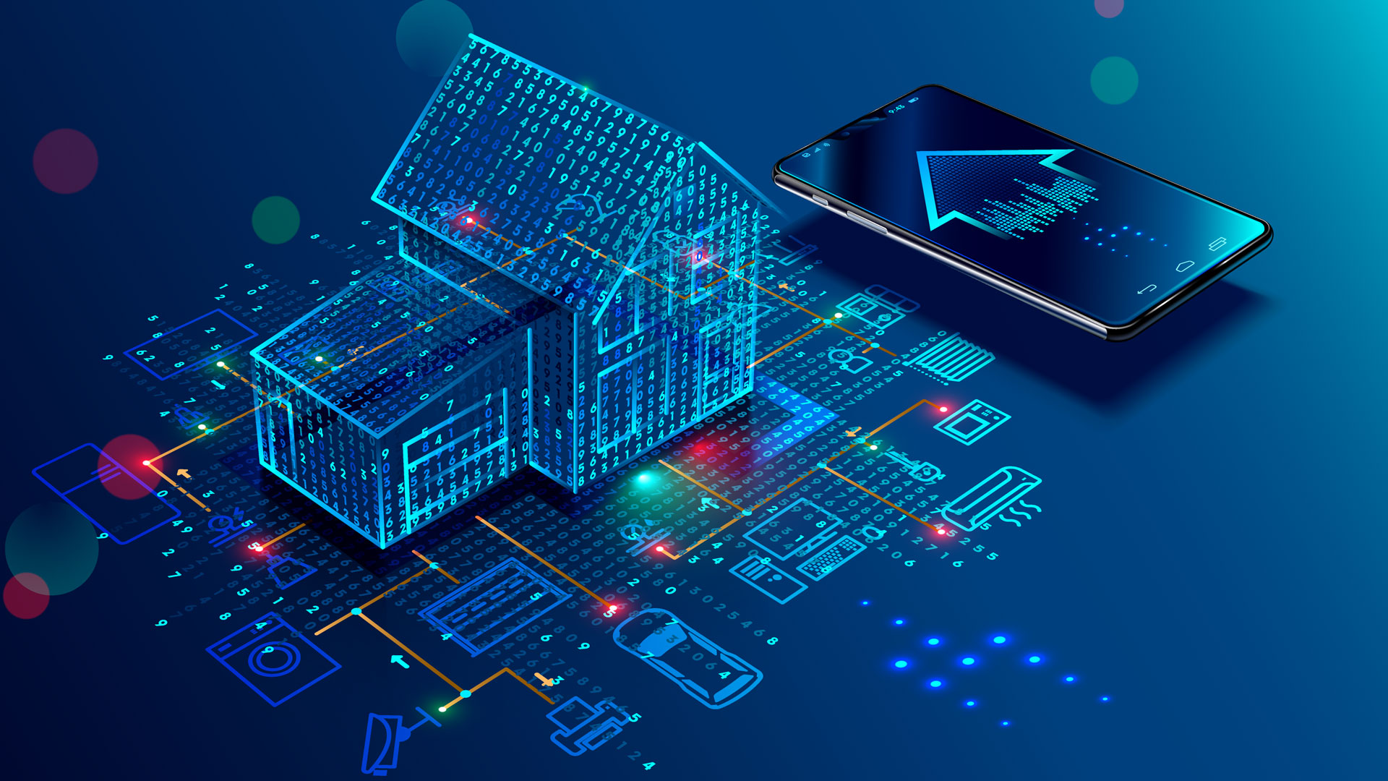

Introduction to IoT
IoT (Internet of Things): A global network of physical devices embedded with sensors, software, and connectivity.
Rapid Growth: Increasing connectivity across homes, cities, industries, and healthcare.
Real-life Examples: Smart homes (Amazon Alexa, Google Home), connected cars, wearable health devices, and industrial automation.

Slide 3

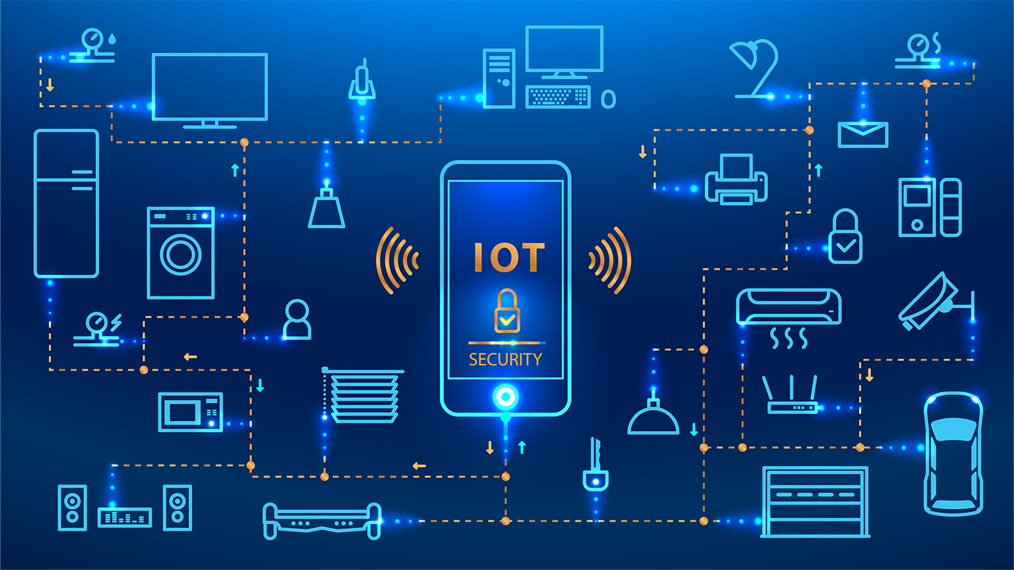
Introduction to Cyber Security in the IoT Era
The Internet of Things (IoT) has revolutionized our world, connecting everyday devices and creating a vast network of interconnected systems. But this connectivity also brings new cyber security challenges, demanding a proactive approach to protect sensitive data and maintain system integrity.

Slide 4


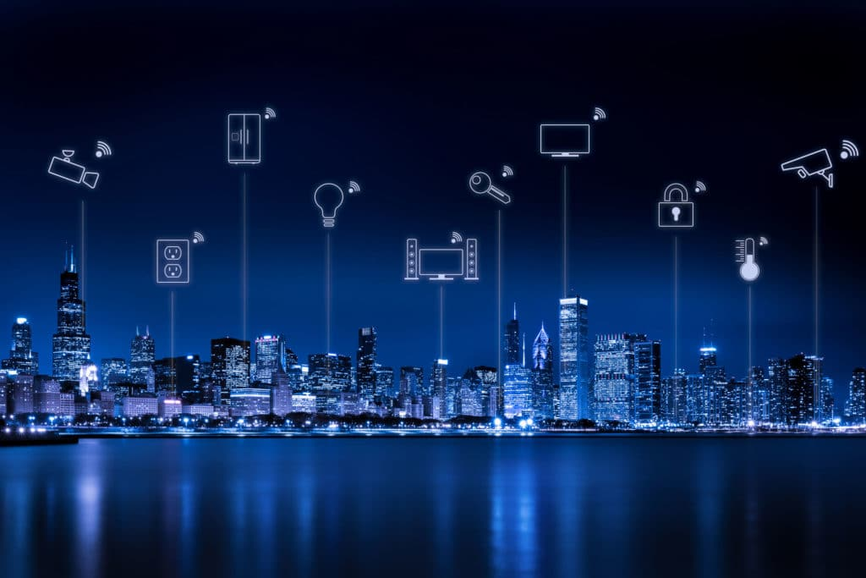
The Rise of the Internet of Things (IoT)
1
Ubiquitous Connectivity
Everyday devices like appliances, cars, and even wearable tech are now equipped with internet capabilities, creating a seamless flow of data and communication.
2
Data-Driven Insights
Vast amounts of data generated by IoT devices provide valuable insights for businesses and individuals, enabling data-driven decision-making and optimization.
3
Smart Cities and Automation
IoT technologies are transforming urban environments, powering smart city initiatives and automating processes for improved efficiency and sustainability.

Slide 5
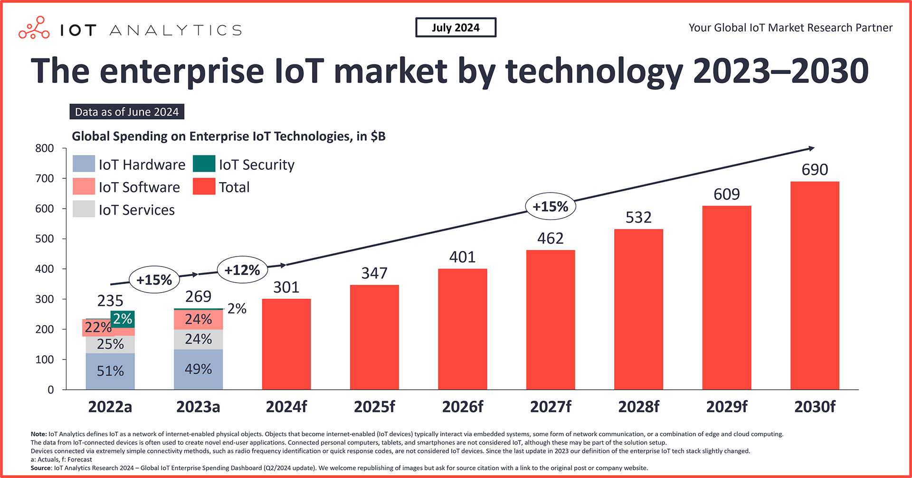
The Rise of the Internet of Things (IoT)
Enterprise IoT market size grew 15% to $269 billion in 2023 year-over-year (YoY). This is lower than the 18% YoY growth in 2022, according to IoT Analytics’ Global IoT Enterprise Spending dashboard—which was updated in June 2024 and includes a look at enterprise IoT spending by region, vertical, and technology, along with a look at 100+ companies. For 2024, IoT Analytics expects growth to slow further to 12%, with the IoT market size expected to reach $301 billion.
Market recovery on the horizon. Enterprise IoT spending shows signs of growth rate recovery starting in 2025, with a CAGR of 15% projected until 2030.

Slide 6

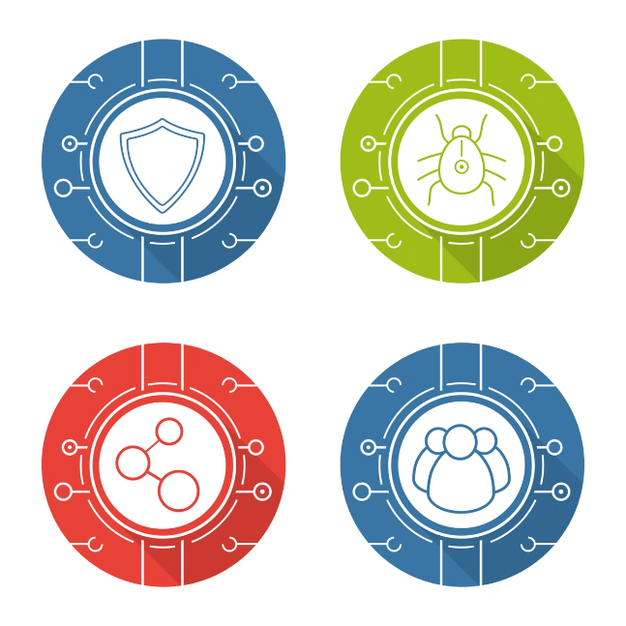
Unique Security Challenges in the IoT Landscape
Device Heterogeneity
Data Privacy and Security
IoT devices vary in security capabilities, creating vulnerabilities when connected to a single network, requiring diverse security solutions.
IoT devices collect sensitive personal data, necessitating robust security measures to protect privacy and prevent unauthorized access.
Widespread Vulnerabilities
The increasing number of connected devices creates more entry points for cyberattacks.

Slide 7
Threats in IoT Devices and Networks
Distributed Denial of Service (DDoS) attacks using IoT botnets.
Man-in-the-middle (MitM) attacks intercepting data between devices.
Data breaches exposing sensitive information.
Ransomware attacks targeting IoT systems.
Physical device tampering and firmware vulnerabilities.

Slide 8
Vulnerabilities in IoT Devices and Networks
Software Vulnerabilities
Weak Authentication
Lack of Encryption
Outdated software and firmware can contain security loopholes, leaving devices susceptible to malicious attacks.
Poorly implemented authentication mechanisms, such as default passwords or easily guessable credentials, create easy access points for attackers.
Insufficient encryption of data transmitted between devices and networks exposes sensitive information to eavesdropping and data breaches.
Other weaknesses:
Poor encryption leading to unsecured data transfer.
Hardcoded credentials that attackers can easily exploit.
Lack of regular software/firmware updates.
Insecure data storage, exposing sensitive information.

Slide 9


Threat Actors Targeting IoT Systems
1
Cybercriminals
2
State-Sponsored Actors
They exploit vulnerabilities to steal data, disrupt operations, and extort money through ransomware attacks.
Governments and intelligence agencies often use sophisticated cyberattacks to gather intelligence and influence foreign policy.
3
Hacktivists
4
Script Kiddies
Motivated by political or ideological agendas, they use cyberattacks to disrupt systems and spread awareness.
Individuals with limited technical skills use readily available tools to carry out basic attacks, often causing unintentional damage.

Slide 10
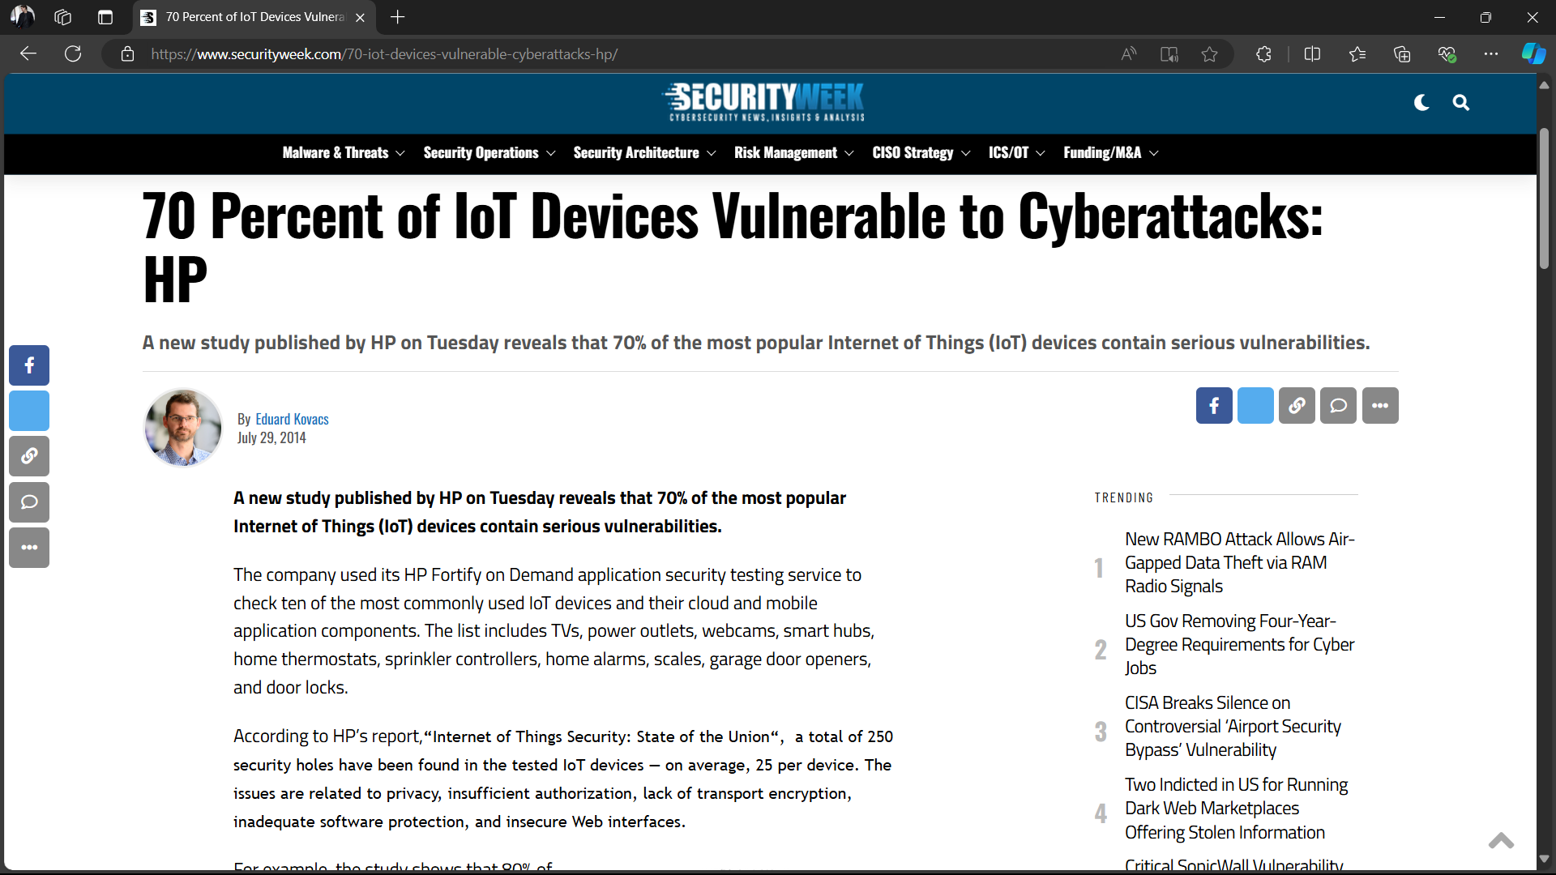

Slide 11
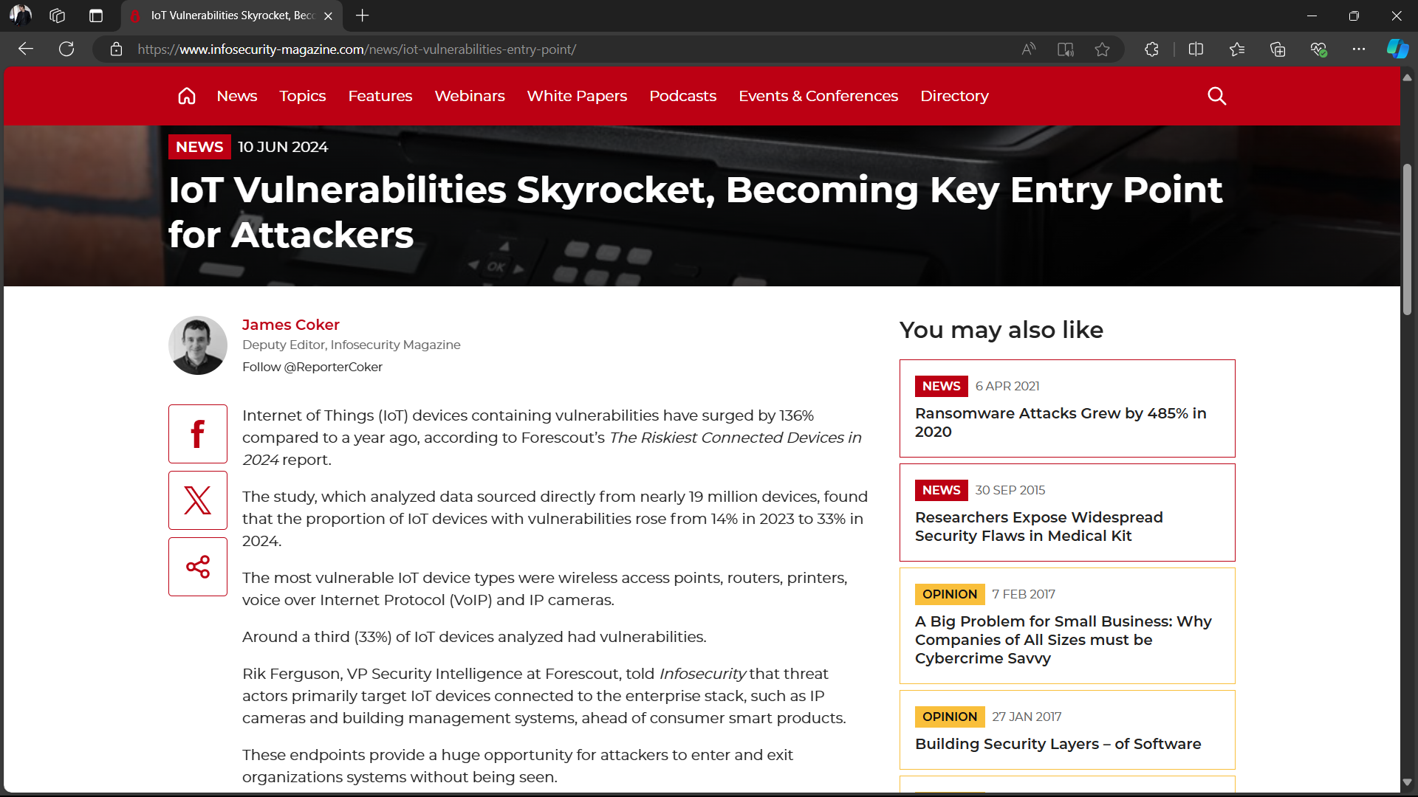

Slide 12
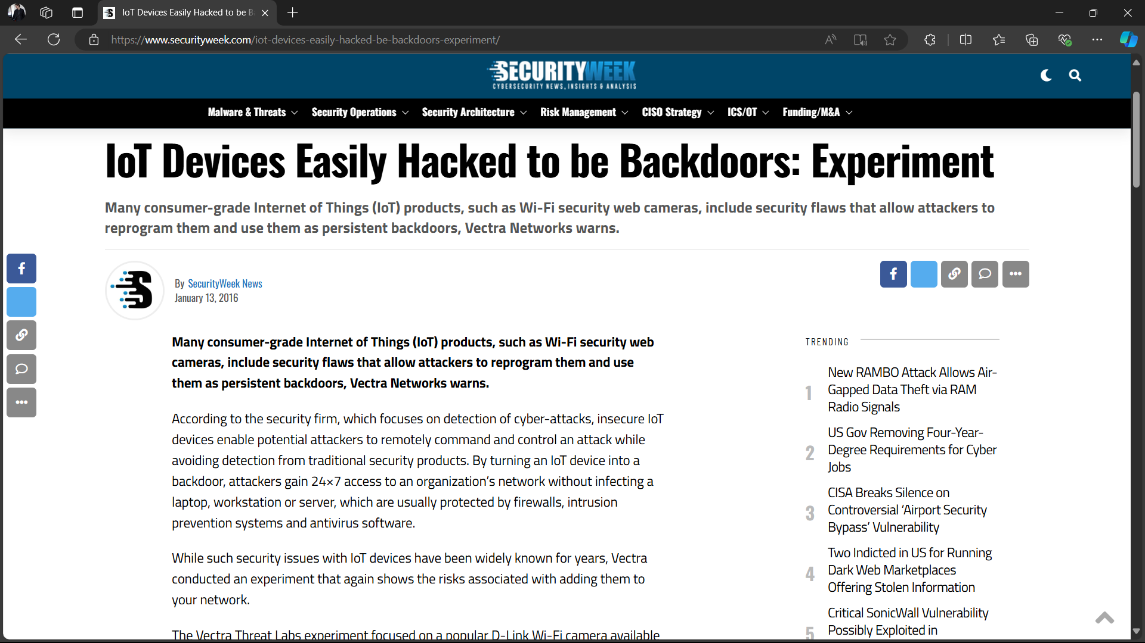

Slide 13
More incident of IoT Cyber Attack
1
Mirai Botnet (2016)
2
Target Breach (2013)
3
Jeep Hack (2015)
This was one of the largest DDoS attacks ever recorded. Hackers took control of IoT devices such as cameras and routers, forming a massive botnet to bring down high-profile websites like Twitter and Reddit.
In this incident, hackers infiltrated Target’s network through the HVAC system, which was connected to the internet as part of their IoT infrastructure. They managed to steal millions of credit card details.
Researchers demonstrated that they could remotely control a Jeep through its IoT system, including braking, acceleration, and steering, highlighting the potential dangers of connected cars.

Slide 14


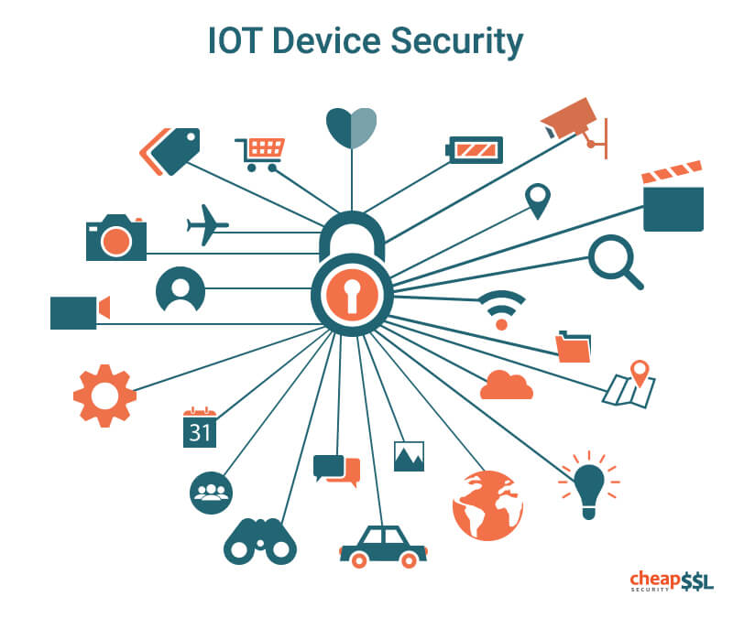



Securing IoT Devices and Networks
Secure Device Development
Implementing secure coding practices and rigorous testing can minimize software vulnerabilities and prevent malicious code injection.
Strong Authentication and Access Control
Robust authentication protocols, such as multi-factor authentication and access control mechanisms, can limit unauthorized access to sensitive data and systems.
Data Encryption and Secure Communication
Utilizing encryption algorithms to secure data in transit and at rest can prevent data breaches and protect against unauthorized access.
Regular Security Updates and Patching
Implementing a comprehensive patch management strategy to address vulnerabilities promptly can mitigate threats and maintain system security.

Slide 15



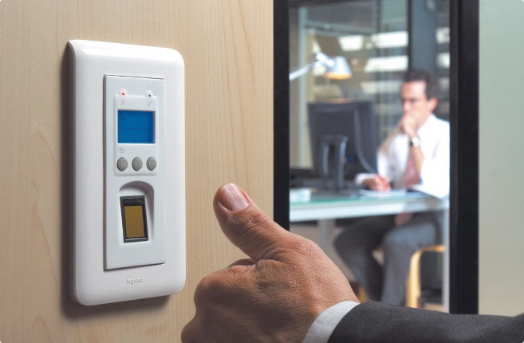


Implementing Robust Access Controls
Role-Based Access Control
Network Segmentation
Granting access to specific functionalities and data based on user roles and responsibilities can effectively manage permissions and prevent unauthorized access.
Dividing the network into smaller, isolated segments can limit the impact of a breach and prevent attackers from spreading laterally.
Multi-Factor Authentication
Access Control Lists (ACLs)
Requiring users to provide multiple forms of authentication, such as passwords, biometrics, or one-time codes, adds an extra layer of security.
Defining specific rules and restrictions for network traffic, such as blocking or allowing certain connections, can enhance network security.

Slide 16


Leveraging Encryption and Secure Protocols
Encryption
Securing data in transit and at rest by converting it into an unreadable format, preventing unauthorized access and interception.
Secure Communication Protocols
Using robust protocols such as TLS/SSL for encrypted communication over the internet can protect sensitive data from eavesdropping and tampering.
Digital Signatures
Ensuring data integrity and authenticity by using cryptographic techniques to verify the sender and prevent data alteration.
Secure Boot
Verifying the authenticity of the operating system and firmware before startup, preventing malicious software from loading at boot time.

Slide 17

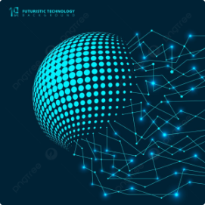
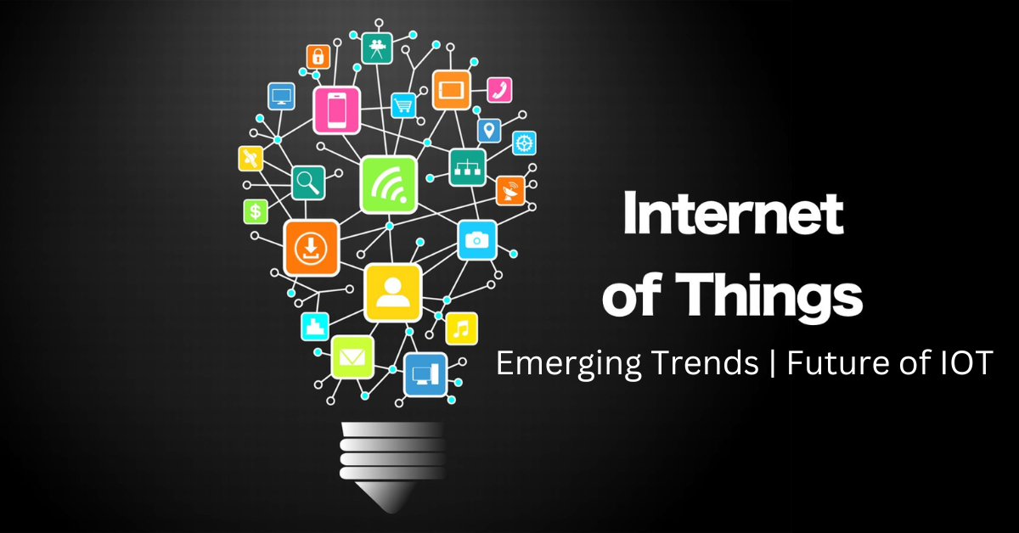
Future Trends and Recommendations
1
AI-Driven Security
2
Edge Security
Leveraging artificial intelligence (AI) to automate security tasks, detect threats, and respond to incidents in real time.
Implementing security measures at the edge of the network, closer to IoT devices, to improve performance and reduce latency.
3
Blockchain Technology
4
Collaborative Security
Utilizing blockchain for secure data storage and authentication, enhancing transparency and immutability.
Promoting collaboration between researchers, security vendors, and governments to share threat intelligence and develop effective security solutions.

Slide 18
References
1
https://www.infosecurity-magazine.com/
2
https://www.securityweek.com/
3
https://images.google.com/
4
https://iot-analytics.com/
5
https://iottechnews.com/

Slide 19
Thank you!!!

